Slide 1

DRAFT DECK FOR PROGAM/PM
Health Plan Data Interoperability (HPDI)
Reducing Provider and Patient Burden by Improving Prior Authorization Processes, and Promoting Patients’ Electronic Access to Health Information

Slide 2
Tech Roll Up - HPDI
Overall Status: At Risk
Item | Responsible | PM Tracking
Author Tech Requirements | Sumana / Sarah | Sarah/Tim/Sumana
UST - CR37 Member Pub. | UST / DK & Sarah | Suresh
Core - VSR – MF1, MF4, MF5 remain | Jennifer V, Kumar Kakani, Sonya Ash, Shivang Patel | Aisha/James (author) Devender (Core)
Sugar Feature ED-1307 | Mitch | Brian/Noel
Author Infrastructure work | Tamas | Janie/Tamas (May not need tracking ask Janie)
Vendor - Data ETL | MavenWave / Sarah | James
Author Interop Data API ED-??? | Sarah | James
Developer Portal | MavenWave / Fredrik | Charles
Testing Design and Data | Author Testing Cynthia | Per each team + UAT
CXP Consent ED-1247/1248 | Fredrik | Charles
OVERALL INTEGRATED TECH PLAN | PMO | Suresh
On Track, At Risk, Off Track, Complete, Not Started

Slide 3
Tech Roll Up - HPDI
Overall Status: At Risk
Item | Responsible | Target | Status | Reason
Author Tech Requirements | Sumana / Sarah | Feb – April 15 | On Track
UST - CR37 Member Pub. | UST / DK & Sarah | Date needed | On Track | UST to publish schedule on 4/5/21 (Suresh)
Core - VSR – MF1, MF4, MF5 remain | Jennifer V, Kumar Kakani, Sonya Ash, Shivang Patel | April 1- May 30 | On Track | Delivery date has downstream impact
Sugar Feature ED-1307 | Mitch | Date needed | Not Started | OCR Delivery within PI7?
Author Infrastructure work | Tamas | 3/12 | Off Track | Still in Discovery/Design
Vendor - Data ETL | MavenWave / Sarah | June 1 | At Risk | Schedule risk: Core data, Author Data.
Author Interop Data API ED-??? | Sarah | Date needed | Not Started | OCR Delivery within PI7? Schedule risk: Core data
Developer Portal | MavenWave / Fredrik | 6/1 | On Track
Testing Design and Data | Author Testing Cynthia | June 1 | Not Started | Need E2E Testing Plan
CXP Consent ED-1247/1248 | Fredrik | 6/15 (PI7 release) | Not Started | OCR Delivery within PI7?
On Track, At Risk, Off Track, Complete, Not Started

Slide 4
UST - CR37 Member Publication
Overall Status This workstream: At Risk
Item | Responsible | Target | Status | Reason
Requirements to UST | Sarah / Author Interop | Fill in | Complete
Estimate received from UST | UST / DK-Suresh | March 26 | Complete
Budget Approval? | Sarah/Author Interop | Fill in | Complete
Schedule for Work | UST / DK-Suresh | ASAP | On Track
Final Delivery | UST / DK-Suresh | May 21? | TBD | Unknown
UST is making a Member Publication – This is a source data input for the system
?
26
?
21
NOW
March 1
April 1
May 1
June 1
July 1
Aug 1
On Track, At Risk, Off Track, Complete, Not Started

Slide 5
Core - VSR Major Features
Overall Status This workstream: At Risk
Item | Responsible | Target | Status | Reason
Major Feature 1 | Sonya Ash, Kumar Kakani, Shivang Patel | April 2 | On Track | (Date may be 4/9)
Major Feature 2 | Shivang Patel | April 30 | On Track | (real time load)
Major Feature 3 | Author: Julia/Karen Core: Sid Sehgal / Tim Sandman | ASAP | On Track | N/A – only needs information
Major Feature 4 | Shivang Patel | May 30 | On Track
Major Feature 5 -Data to Author | Jennifer Vesole | May 30 | Not Started | This date is not ideal
Core MFs are source data inputs for the system
?
26
?
21
NOW
March 1
April 1
May 1
June 1
July 1
Aug 1
On Track, At Risk, Off Track, Complete, Not Started

Slide 6
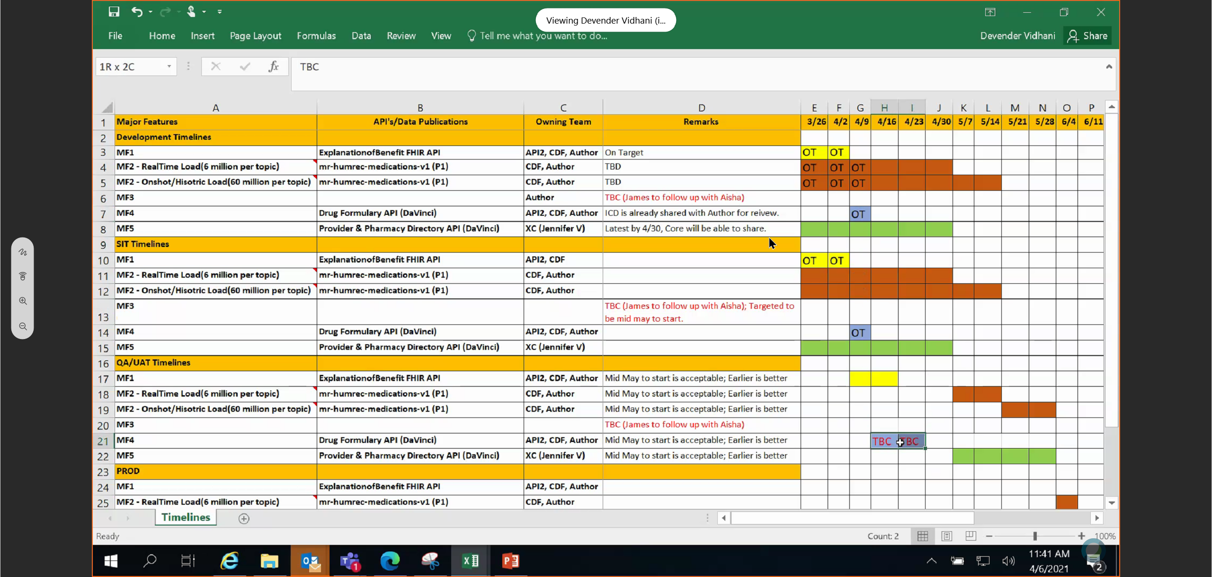
James
Core - VSR Major Features Detail
VSR Timeline by Major Feature (From Devender's report)
MF1 + team
Requested dates from Google are 4/1 [Sarah]
MF2 + team
Requested dates from Google are 4/22 [Sarah]
MF3 + team (tech owned – timeline TBD) [James]
MF4 + team
For MF4, we last recorded as 5/30 to complete development [Devender]
MF5 + team
4/30 is when the core is to receive the information. [Ashley Heitzmann]
5/30 is when the information will be shared with Author. [Ashley Heitzmann]
Note that these connect with the Author Interop features for PI7. (API connection to the ETL system)

Slide 7
James
Sugar Feature ED-1307
This is being handled by Mitch(Noel)/Brian
Grooming
PI planning
Delivery date – suggest one!
Sugar Feature is a source data input for the system

Slide 8
Author Infrastructure – (Janie Please fill in)
Item | Responsible | Target | Status | Reason
Vendor Onboarding | Author CloudFit | 3/12 | Complete 3/19
Author Infrastructure work | Author GCPOps | 3/12 | Off Track | New Date of 4/12
Infrastructure
Decision: (Ian/Kapil/Tamas) 4/2
We will go forward with the subscription model for infrastructure
This enables the work to move forward
Later in time (after 7/1) we may make a transition on infrastructure.
Security Issue – impact has been mitigated.
GCP for development to be a MavenWave Environment until Security issues are resolved.
Allows install with MavenWave (4/12) so they can continue with mapping/development.

Slide 9
Vendor Data ETL (Mavenwave*)
Overall Status This Workstream: At Risk
Item | Responsible | Target | Status | Reason
Data Analysis | MavenWave/Sarah | April 1 | At Risk (Need to replan) | Data input availability is 80%
Data ETL | MavenWave/Sarah | May 15 | At Risk
Data Quality Assurance | MavenWave/Sarah | June 1 | Not Started
Final Delivery | MavenWave/Sarah | June 1 | At Risk | At risk as unknown
* Mavenwave is a Google subcontractor
1
15
1
NOW
March 1
April 1
May 1
June 1
July 1
Aug 1
On Track, At RIsk, Off Track, Complete, Not Started

Slide 10
James
Testing for Interop
This is being handled by Cynthia/Sarah?
Ensure that convo is understood.
What do you or your team need for testing ? contacts? How you want to handle it is.
(Ask Cynthia how to handle it)

Slide 11
CXP Customized App Portal
Overall Status This workstream: On Track
Item | Responsible | Target | Status | Reason
Auth0 POC | Mavenwave | Mid May Mid April | Not Started | Week of 4/12
Integrate with Apigee | MavenWave | April 16 | Not Started
Consent ED-1248 | Author - CXP | June 15 ? | Not Started | Part of PI7 Work
Revoke Consent ED-1247 | Author - CXP | June 15 ? | Not Started | Part of PI7 Work
SIT/UAT -> Release | MavenWave/Author CXP | June 15 ? | Not Started | Part of PI7 Work
16
14
18
NOW
March 1
April 1
May 1
June 1
July 1
Aug 1

Slide 12
Developer Portal
Overall Status This workstream: On Track
Item | Responsible | Target | Status | Reason
Generic Portal POC | MavenWave | Apr2 | On Track
Branding Assets/Guidance | Author – Design/Comms | May 3 | On Track
Integrate with Apogee | MavenWave | April 16 | On Track
Connect to Swagger Dev | MavenWave | May 14 | Not Started
Final Brand Adj. Per Author Comms | MavenWave/Author CXP | By June 1 | Not Started
SIT/UAT -> Release | MavenWave/Author CXP | By June 25 | Not Started
2
3
14
1
25
NOW
March 1
April 1
May 1
June 1
July 1
Aug 1

Slide 13
Author HPDI Program & Timeline to 7/1/2021
Contract Phase 1
Contract Phase 2
Tech Data Workstream
Vendor
Both
Security testing can -> 100%
4 weeks Support
Data Verified –> Data Mapping 100%
E2E testing can be done
Training/Support enabled on lower environment
Core VSR
?
Need API Specs/Tech Info!!
Core APIs go live?
?
?
?
This is not OK and needs an agreed solution. Needs Ashley/Matt Bone’s help (Devender)
Data Questions (Author/Core)
PIRC (done)
Implement Security and test (with Vendor)
SAR (To Do)
UAT
March 1
NOW
May 1
July 1
April 1
June 1

Slide 14

Major Milestones and Target Dates
Milestone | Target Date
Finalize source system(s) for data subjects (90% Done) | 2/19/2021
Submit request for PIRC approval (Done) | 2/19/2021
Kick off engagement with Google and determine pre-work needed by 3/1 (Done) | 2/25/2021
Complete prep work for Google engagement to kick-off (80%) | 3/1/2021
Formalize requirements for source data needed (80%) | 3/5/2021
Gain core commitment to deliver source data needed (80%) | 3/12/2021
Finalize Infrastructure Planning | 3/12/2021
Google deliverables as part of phase 1 contract:
High-Availability Deployment​ (Delayed) | 4/23/2021
Minimal viable product(MVP) data engineering and data integration to FHIR format​ (Delayed) | 4/23/2021
System conforming to CMS Interop requirements on test data provided​ (Delayed) | 4/23/2021
Infrastructure manifest and architecture diagram (Delayed) | 4/23/2021
End-to-end auto-scaling platform/pay-as-you-go​ | 4/23/2021
Finalize contract for phase 2 of delivery (WIP) | 4/25/2021
Core – Sample Data 80%
Core – 3 APIs needed
14

Slide 15
Author HPDI Engineering Team
Person | Author Role | Role on HDMI team
Sumana | Solution Arch | Responsible for overall architecture (i.e. L0)
Tim | Solution Arch | Responsible for project specific architecture (i.e. L1)
Aakash | Engineering Leader | Google relationship mgr and engineering liaison
James Charles | Project Managers | James – Interop Charles – Digital Experience
Fredrik | SDL for Digital Exp | Responsible for member portal delivery
Sarah | SDL for Interop | Responsible for interop delivery
Catherine | Business Consultant | Oversees data mapping for data subjects and attributes
Ronald | Product Mgr for Digital Exp | Responsible for digital requirements
Carlene | Compliance Leader | Ensures team is interpreting CMS guidance correctly
15

